Slide 1
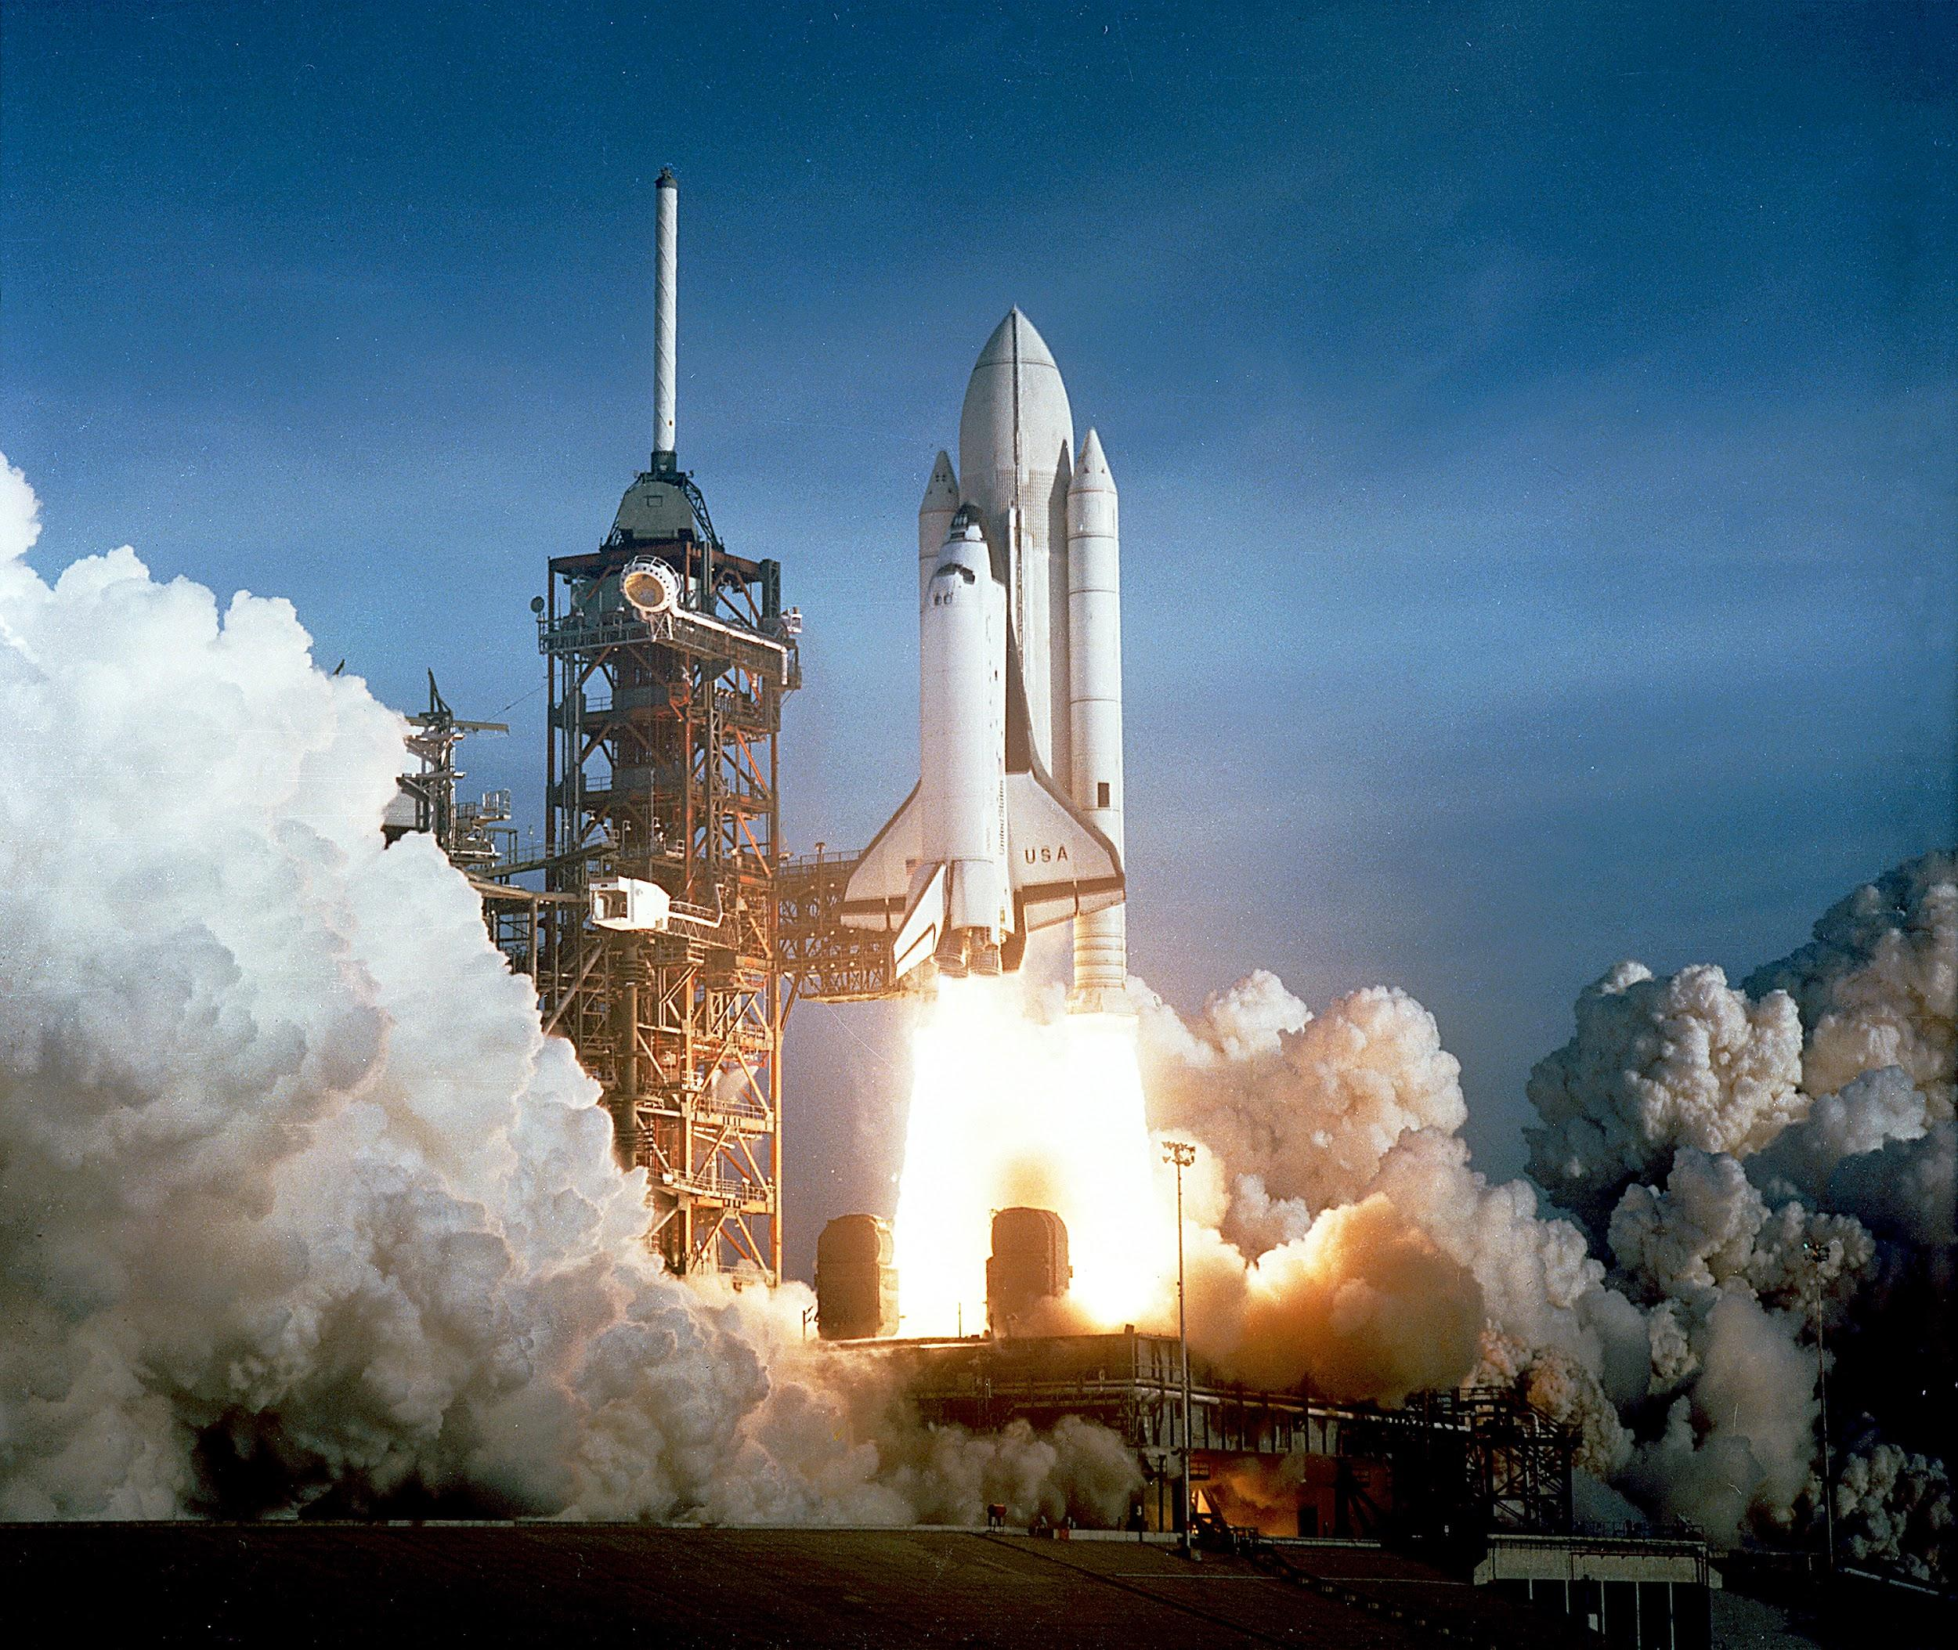
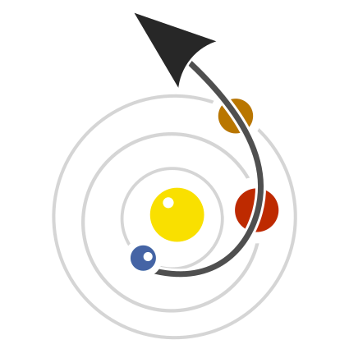


Through Python to the Stars!
Shreyas Bapat @shreyasbapat
PyCon India @ Hyderabad - 27/10/2018
shreyasb.com

Slide 2
Who’s this person?
Amateur Astronomer
Undergrad. @ IIT Mandi
Open Source Enthusiast
Ex-Co-ordinator STAC-IITMandi

Slide 3
What’s actually Astrodynamics/Orbital Mechanics?
Physics > Mechanics > Celestial Mechanics > Astrodynamics
“A branch of Mechanics (itself a branch of Physics) that studies practical problems concerning the motion of human made objects trough space”

Slide 4

Don’t Worry if you are like!

Slide 5


Warning!

Slide 6

Source: https://www.youtube.com/watch?v=-kRQiPATxCM

Slide 7

Wait!
Is it related to Python?

Slide 8


Slide 9
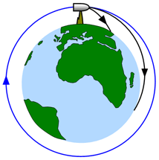
Newton’s Canonball

Slide 10

Remember this?

Slide 11
Newton’s Canonball

Slide 12
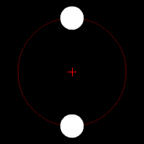
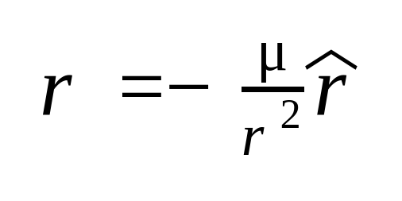
Two- Body Problem
Main problem in Celestial Mechanics
Two Point Masses
Only Gravitational Forces Considered
The two motions are now decopouled.
..

Slide 13
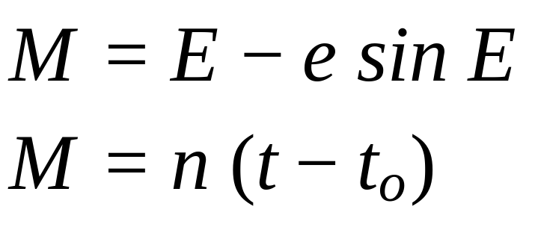
Kepler Problem
Kepler’s Problem is the initial value problem (IVP) of the two body problem also known as propagation.
In short, given its state at some time, determine where it will be after “x” amount of time. Determine it’s velocity and position!
For elliptic orbits,

Slide 14
Lambert Problem
Lambert Problem is the boundary value problem (BVP) of the two body problem.
In short, we have to determine trajectory of an object between two positions to be travelled at two times.
Planet’s are point masses -> Consider only SUN } Patched conic approximation

Slide 15
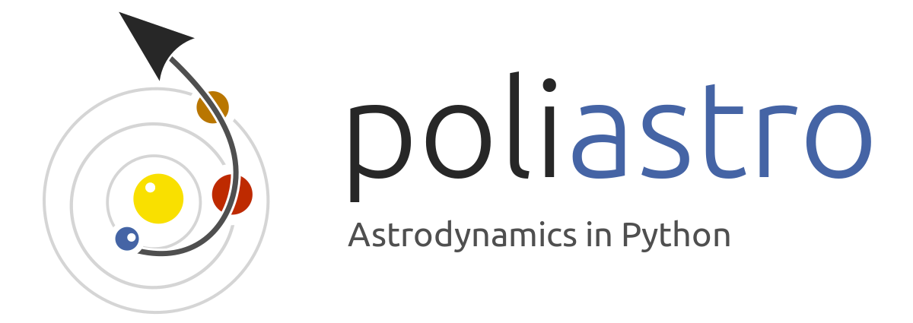
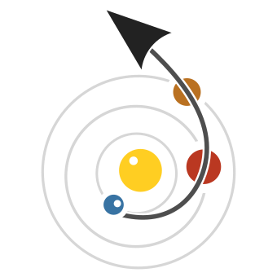
Poliastro : AstroDynamics in Python
Pure Python accelerated with numba.
MIT Licence (Permissive)
Analytical and numerical orbit propagation.
Conversion between position and velocity vectors and classical orbital elements.
Coordinate frame transformations.
Hohmann and bielliptic maneuvers computation.
Trajectory plotting - 3D and 2D
Initial orbit determination (Lambert problem)
Planetary ephemerides (using SPICE kernels via Astropy)
Computation of Near-Earth Objects (NEOs)

Slide 16

AstroPy : Astronomy in Python
Standard library for Astronomy Projects in Python
Physical Units: (astropy.units) : Static Typing for Engineers
Dates and Time: (astropy.time) : time vectors, conversion to Julian Dates(JD) and SOFA Routines.
Reference system conversion: (astropy.coordinates)
Other Cosmological computations (astropy.cosmology), FITS data (astropy.io.fits)
Astroquery
AstroPy Helpers

Slide 17

Numba : JIT for numerical Python
numba is a BSD licensed, just-in-time compiler for numerical Python code.
Optimised to work with NumPy Arrays
Extending support to subset of the language (It hurts the performance)
Compiles to LLVM, hence leveraging its power to this powerful toolset.
Support for GPU’s too!

Slide 18

Plotly : Interactive Plotting in Python
plotly.py is a MIT licensed, interactive, browser-based graphing library for Python
Major Release: Plotly 3.0
First Class Jupyter Widget Support
Context Manager for Animations!
3D and 2D plotting.
Provides public, private, and on-premise platforms for publishing graphs, datasets, and interactive Dash applications.
Dash!!

Slide 19

This is Python!

